Slide 1
Final Engagement
Attack, Defense & Analysis of a Vulnerable Network

Slide 2
Table of Contents
This document contains the following resources:
Network Topology & Critical Vulnerabilities
Exploits Used
Avoiding Detect
Maintaining Access

Slide 3

Network Topology
& Critical Vulnerabilities
3

Slide 4
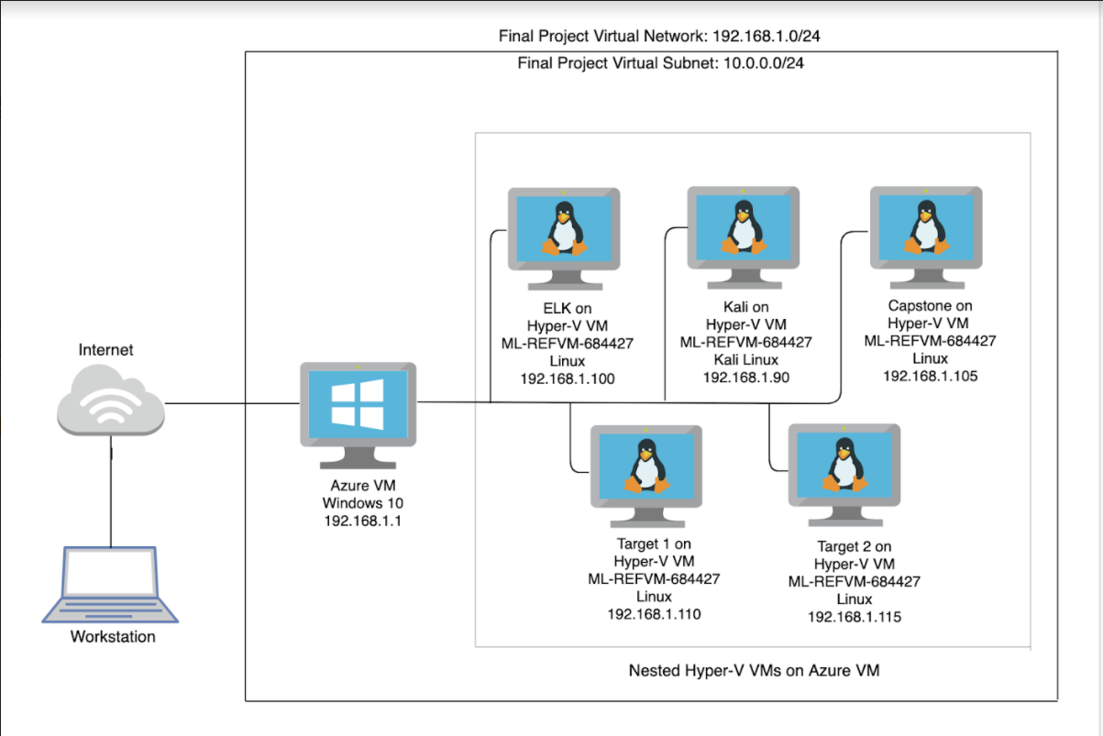
Network Topology
Network
Address Range:192.168.1.0/24
Netmask:255.255.255.0
Gateway:
Machines
IPv4:192.168.1.110
OS:Linux
Hostname:Target 1
IPv4:192.168.1.115
OS:Linux
Hostname:Target 2
IPv4:192.168.1.90
OS:Linux
Hostname:Kali
IPv4:192.168.1.100
OS:Linux
Hostname:Elk

Slide 5
Critical Vulnerabilities: Target 1
Our assessment uncovered the following critical vulnerabilities in Target 1.
Vulnerability | Description | Impact
Enumeration User disclosure from 2 separate locations | Using either enum4linux or wpscan an attacker can gain access to usernames, enum4linux giving a more complete look | Gives the attacker a list of users to attempt to brute force the password.
Weak passwords | 3 accounts have either a username for a password, or the reverse spelling of the username as the password | ¾ user accounts are using default passwords or passwords that are otherwise easy to guess. Two of these accounts provide passwordless sudo use (root+vagrant) and the last was a no brainer to guess. The strongest password on the machine was cracked in under 5 minutes.
Port 22 Open | When port 22 is open it allows attackers to ssh and use brute force attacks on systems | Attacker can craft an attack method that exploits having ssh open such as a brute force
CWE-307: Brute Force attacks | Improper Restriction of Excessive Authentication Attempts | Gives attacker higher chance of success for brute force attacks

Slide 6
Critical Vulnerabilities: Target 1
Our assessment uncovered the following critical vulnerabilities in Target 1.
Vulnerability | Description | Impact
Root password of the database in the wordpress configuration file | Database root password was stored in an application configuration file | This has a high impact because the threat can gain access to machine, the password will be easily available and they can quickly gain access to the database.
Privilege escalation by sudo python (CVE-2006-0151) | Allows a local users to gain privileges by using a Python script | provides root escalation this is very dangerous and impactful because it provides root to the threat actor

Slide 7
Critical Vulnerabilities: Target 2
Our assessment uncovered the following critical vulnerabilities in Target 2.
Vulnerability | Description | Impact
unprotected access to sensitive data | The vendor page is open to the public and contains vulnerability information and confirmation the version in use is vulnerable | The attacker was able to retrieve version information, vulnerability info (which included the current version and a link to a near ready to use exploit)
phpmailer CVE-2016-10033 | Not only was the version in use vulnerable, the vulnerability was included in the documentation. | The mailSend function in the isMail transport in PHPMailer before 5.2.18 might allow remote attackers to pass extra parameters to the mail command and consequently execute arbitrary code.
Wp-config not locked down | Because the config file isn’t locked down the attacker gained access to the mysql password | This has a high impact because the threat can gain access to machine, the password will be easily available and they can quickly gain access to the database.
Mysql UDF dynamic library Privilege escalation | A well documented exploit is available ready to compile that allows an unprivileged user to gain root | This allowed the attacker to jump from the www-data user to root
Notes:
William Hart

Slide 8
Exploits Used
8

Slide 9
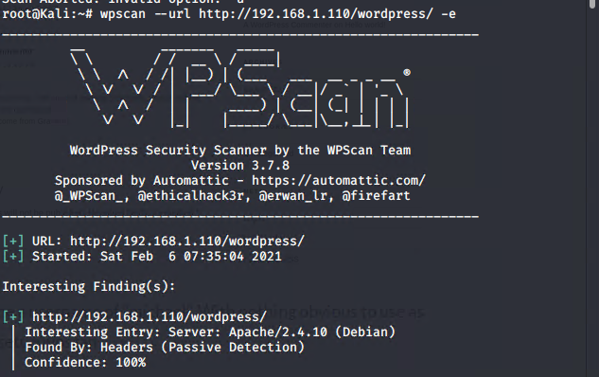
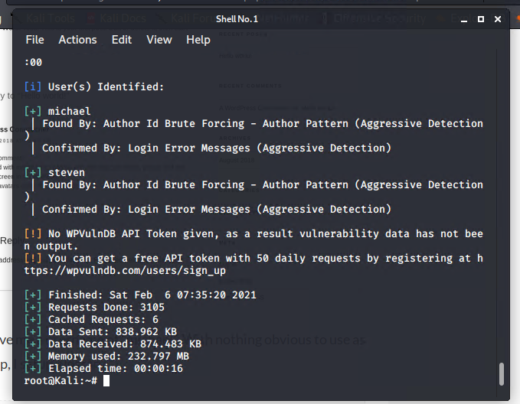
Exploitation of target 1: 1[Enumeration]
enum4linux scan
wpscan enumeration gave us 2 users Michael and Steven

Slide 10
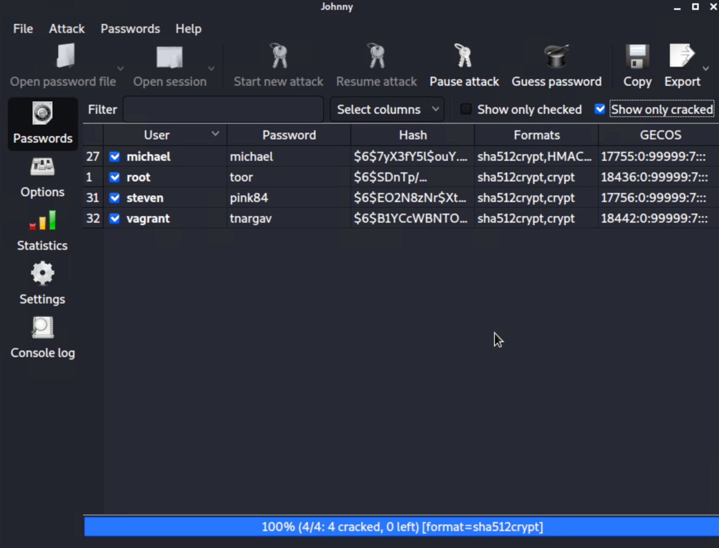
Exploitation of target 1: 2 [Weak Passwords]
Some of the passwords were default and some used the actual users name as the password which was guessable.

Slide 11
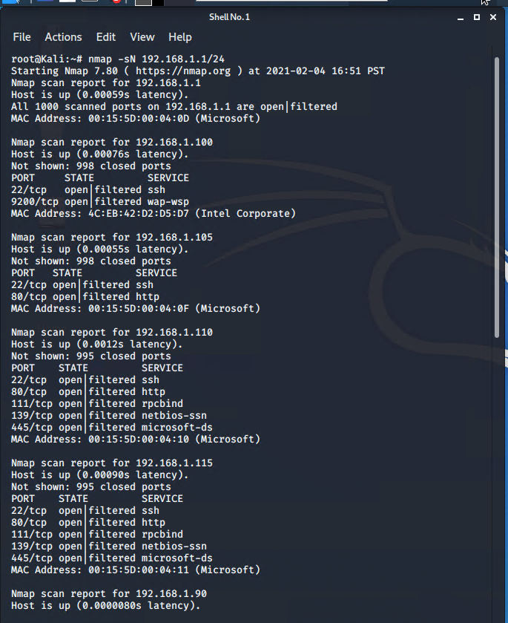
Exploitation of target 1: 3 [Port 22 Open]
A nmap scan of of the range 192.168.1.1/24
This showed us that the target left the ssh port open.

Slide 12
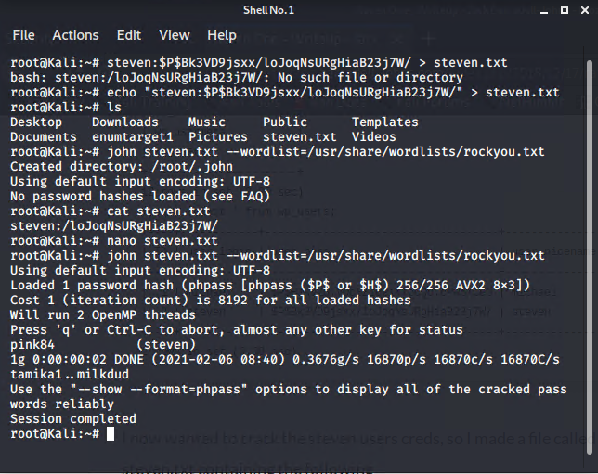
Exploitation of target 1: 4 [CWE-307: Brute Force attacks]
Used john to brute force on the user steven to get password.
This gave us the password for user steven:pink84
We could have also used this method this for user michael but the password was guessed beforehand.

Slide 13
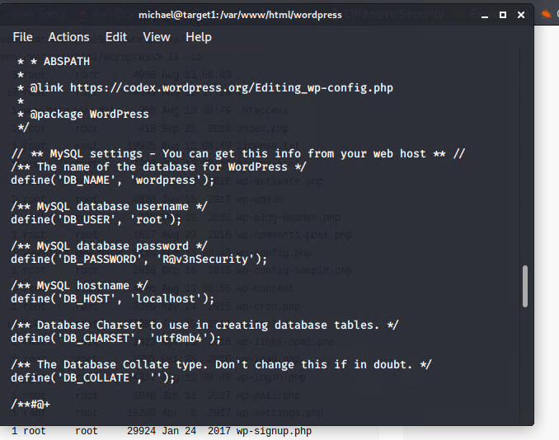
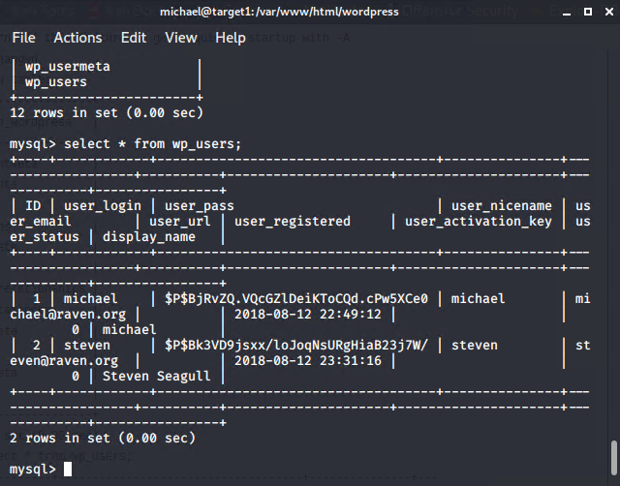
Exploitation of target 1: 5 [Root password in the wordpress configuration file ]
We were able to SSH into Michael’s account using his credentials - User:michael Passwd:michael. we then located the wp-config.php file and discovered MySQL database login credentials
As following:
ssh michael@192.168.1.110
find -iname wp-config.php
cd /var/www/html/wordpress
cat wp-config.php
Credentials: User=root
Passwd:R@v3nSecurity
Access to Mysql led to us getting the hashes for both users Michael and Steven

Slide 14
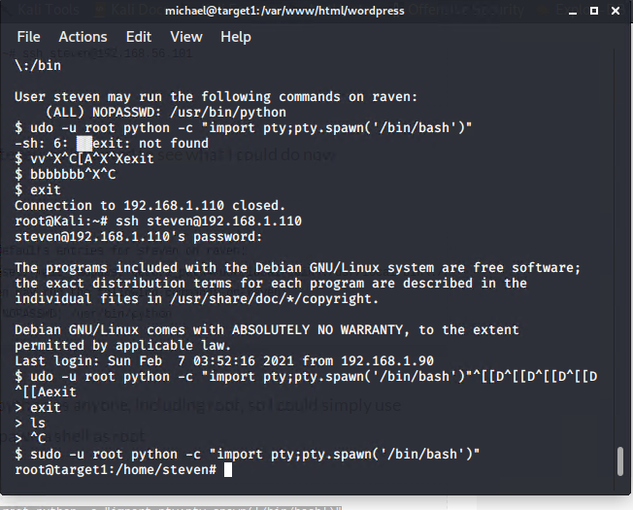
Exploitation of target 1:6 [Privilege escalation by sudo python (CVE-2006-0151) ]
In My SQL Database, commands;
show database
use word press
show tables
select from wp_users
After getting Steven’s password hash from MySQL database we saved to steven.txt we cracked with John Passwd: pink84. We then SSH into Steven’s account and used this command sudo -u root python -c "import pty;pty.spawn('/bin/bash') to get escalated to root via sudo python.

Slide 15
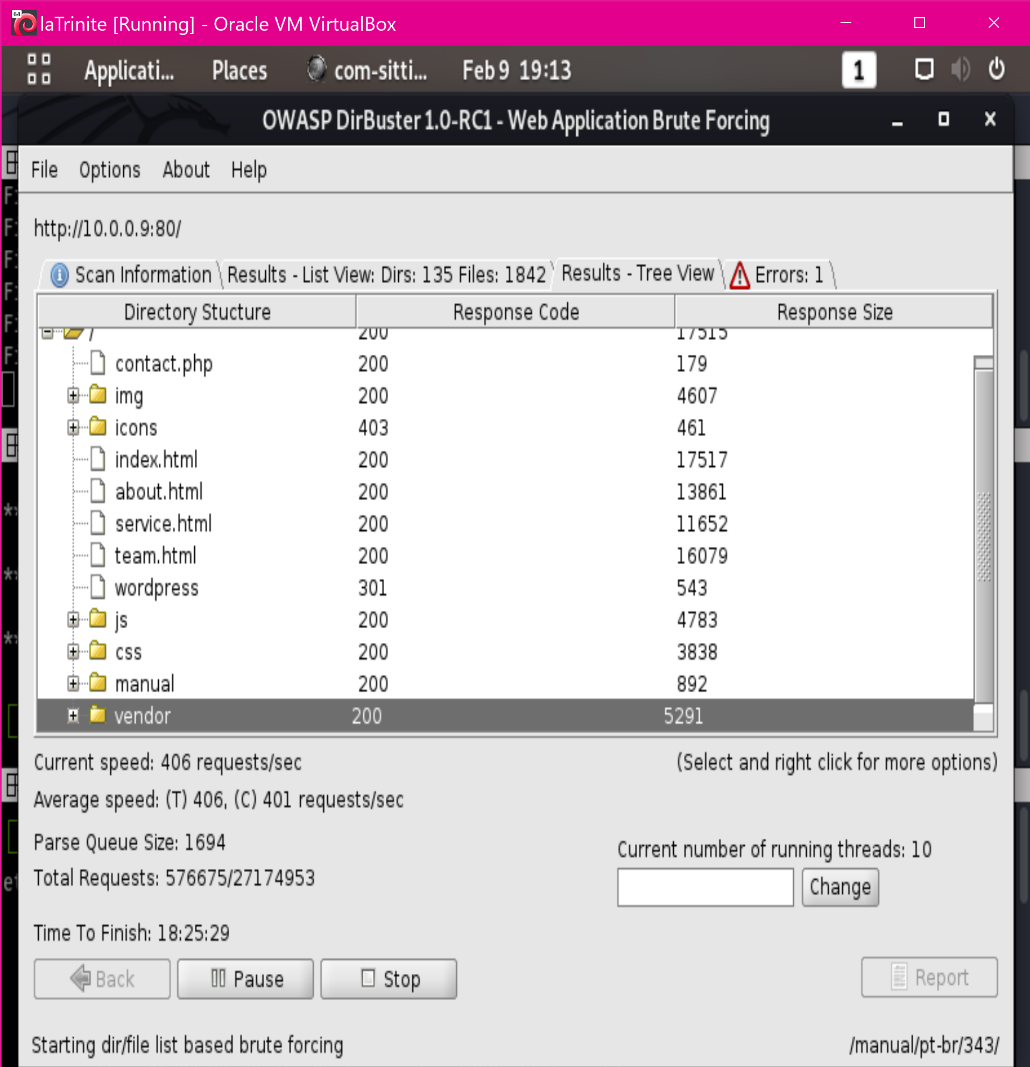
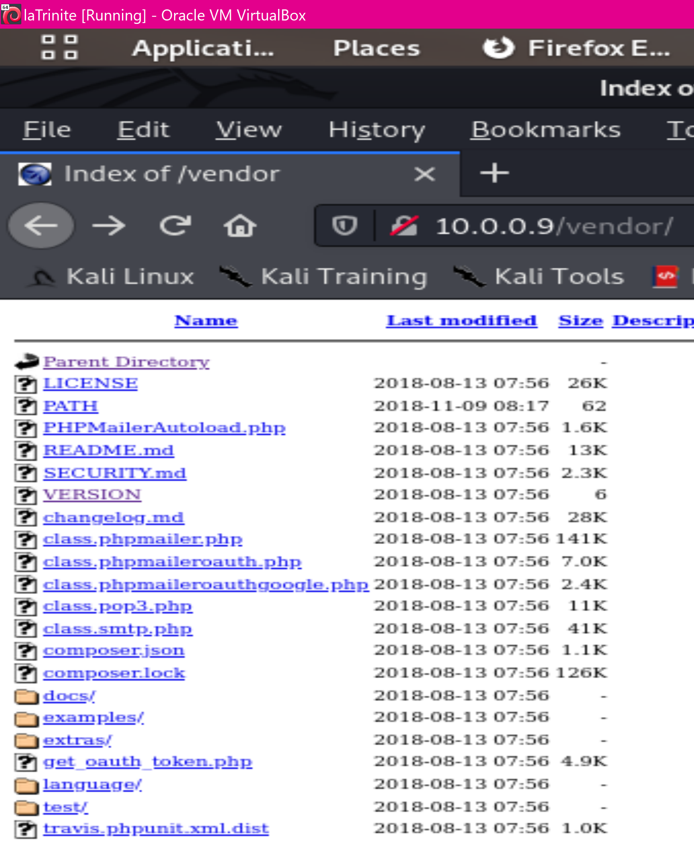
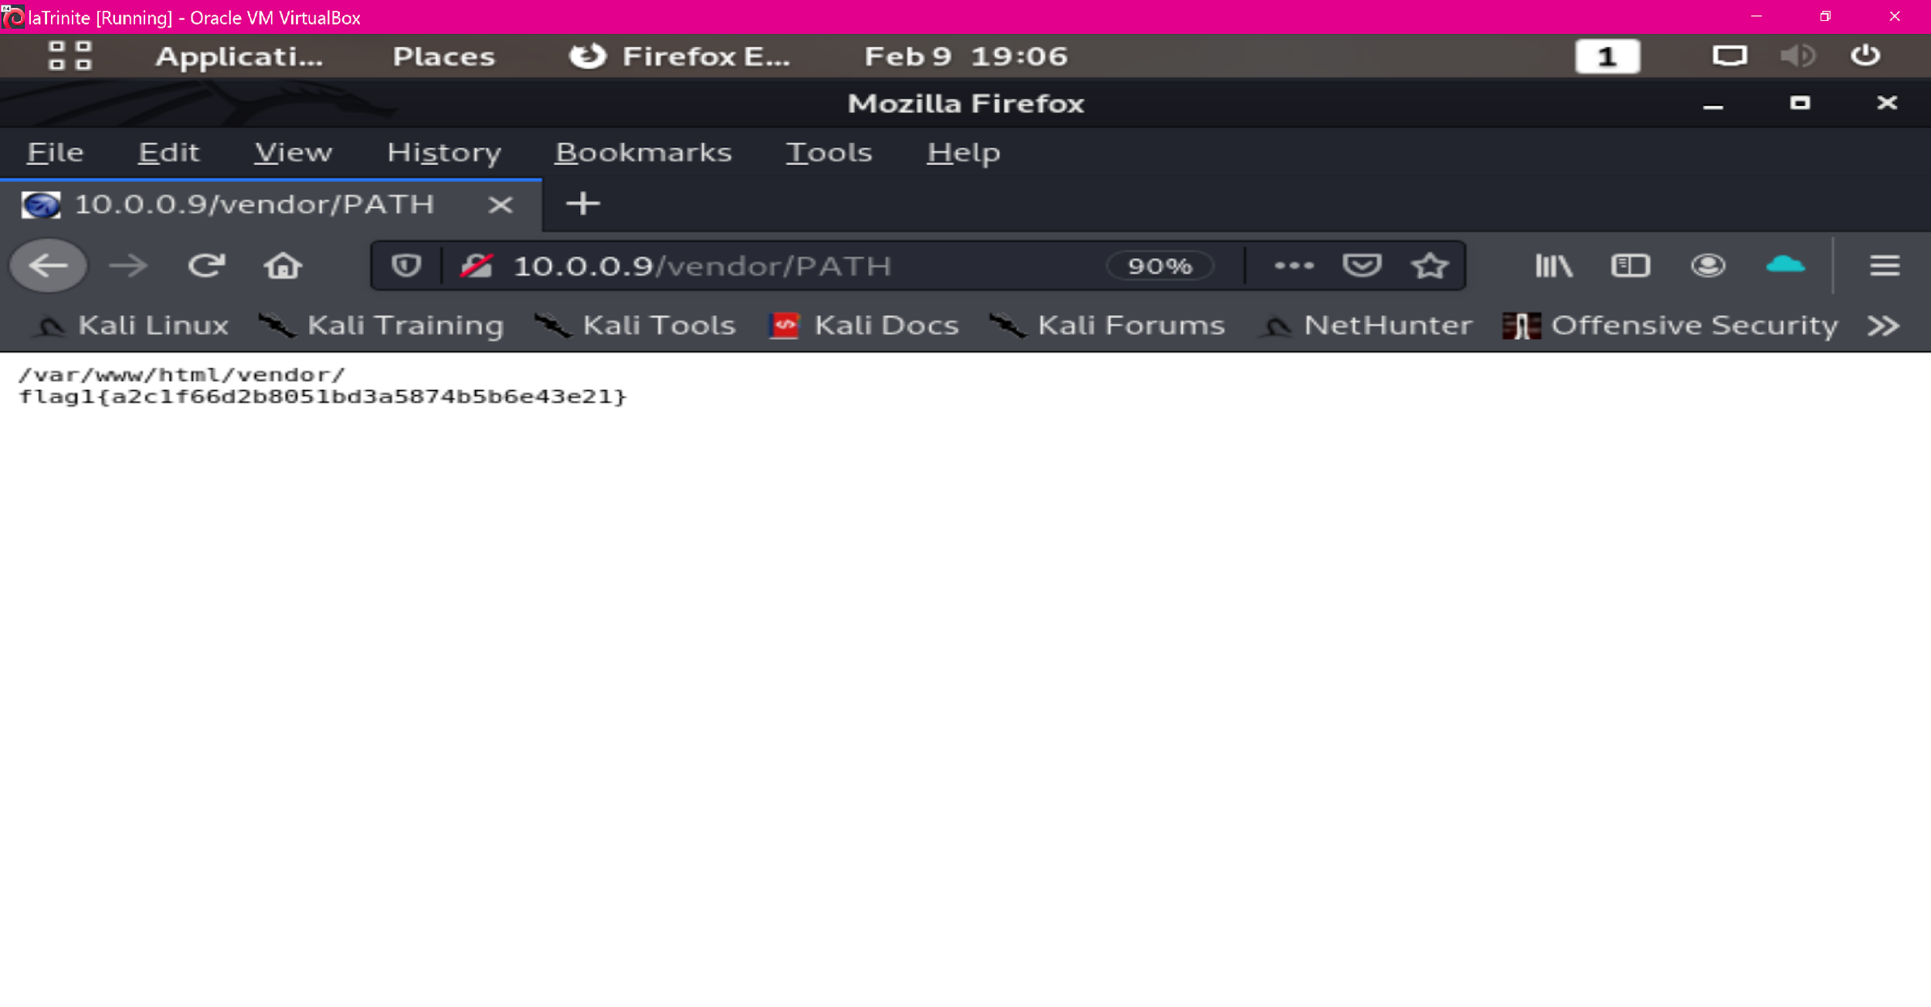
Exploitation of target 2: [unprotected access to sensitive data]
Using dirbuster to enumerate the directory’s accessible from the web the attacker found the /vendor folder
Inside this folder is the phpmailer version, detailed notes on vulnerabilities the version is weak to and even links for futher analysis.
Flag 1 was captured from the PATH file inside this folder.
Notes:
William Hart

Slide 16
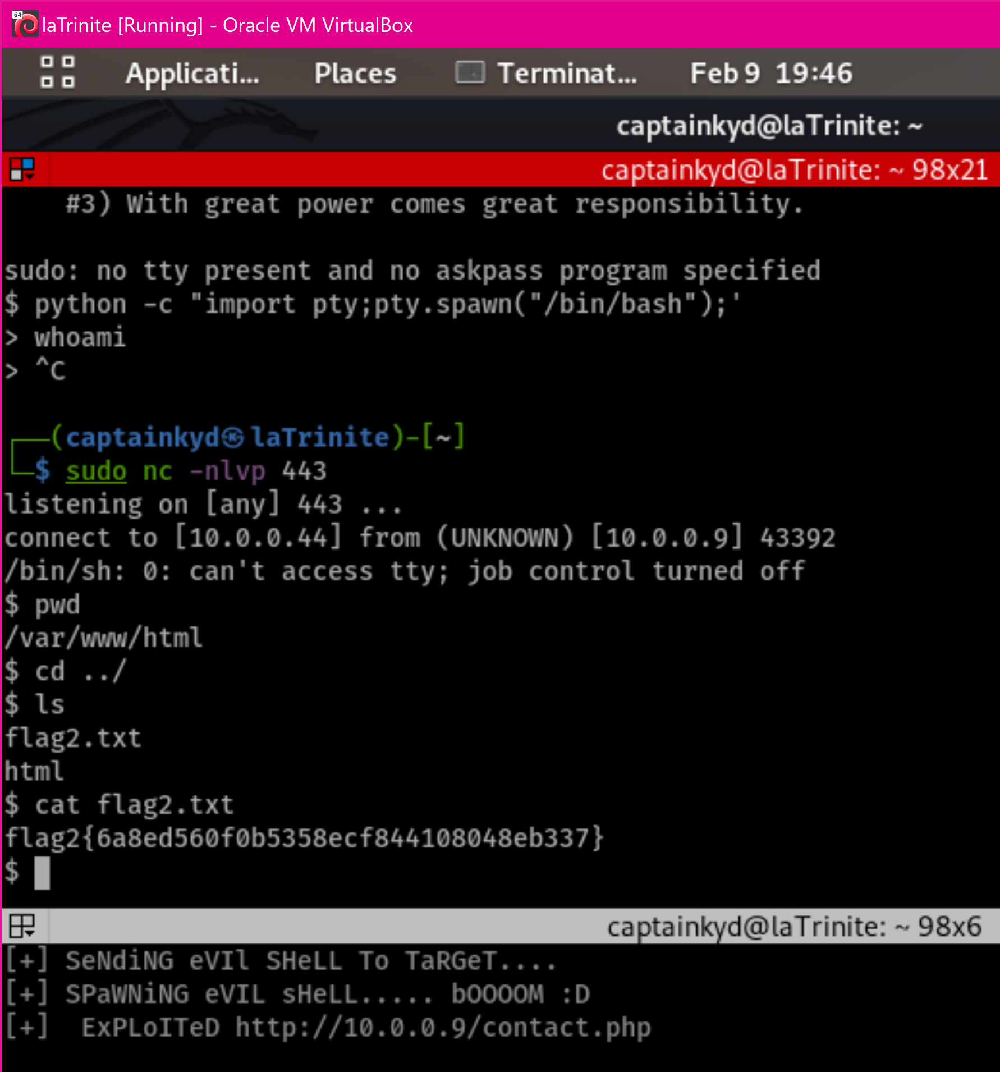
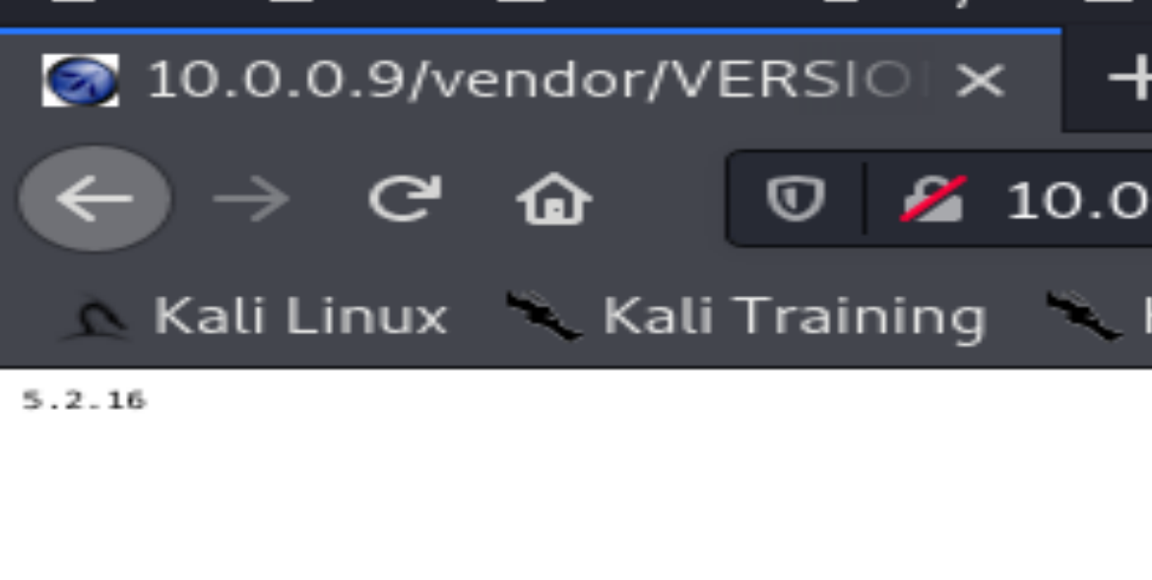
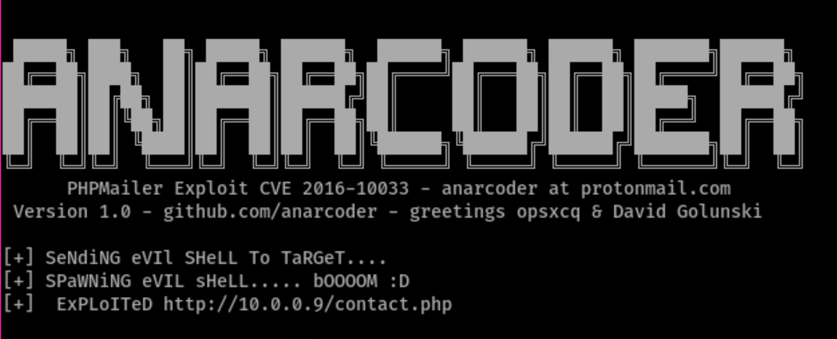
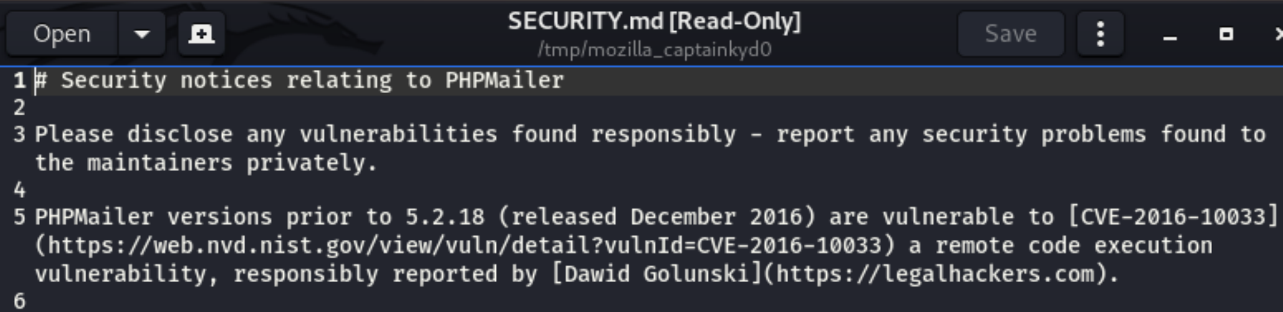
Exploitation of target 2: [phpmailer]
Phpmailer version 5.2.16 contains known vulnerabilities. So well known in fact, that the SECURITY.md file states the cve number, a link for more details, etc. The exploit used was a ready packaged anarcoder python script that was easily editable to tailor it for the system.
Through this exploit a shell was obtained for the www-data user allowing the capture of flag 2.
Notes:
William Hart

Slide 17
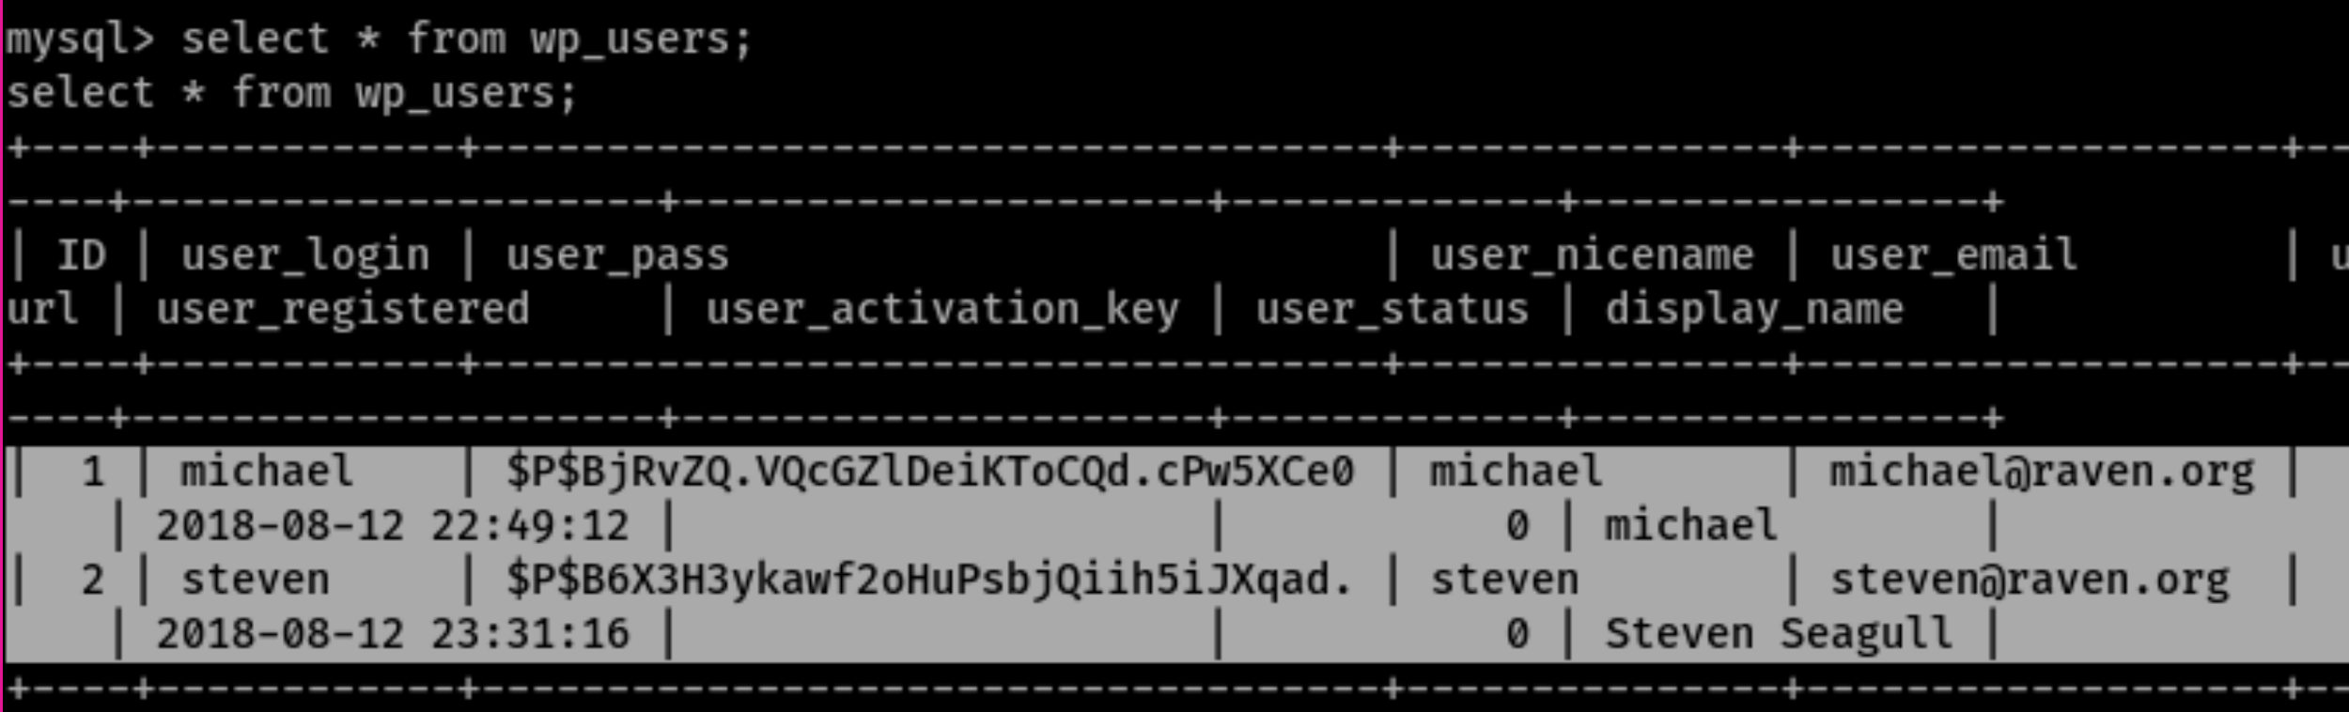
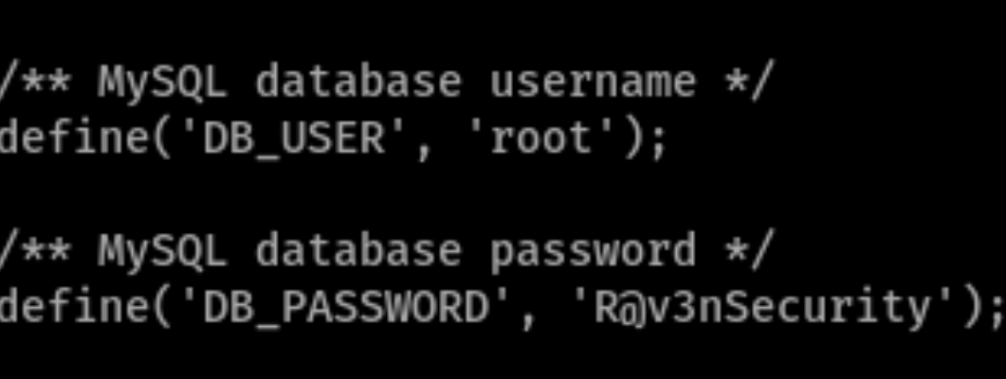
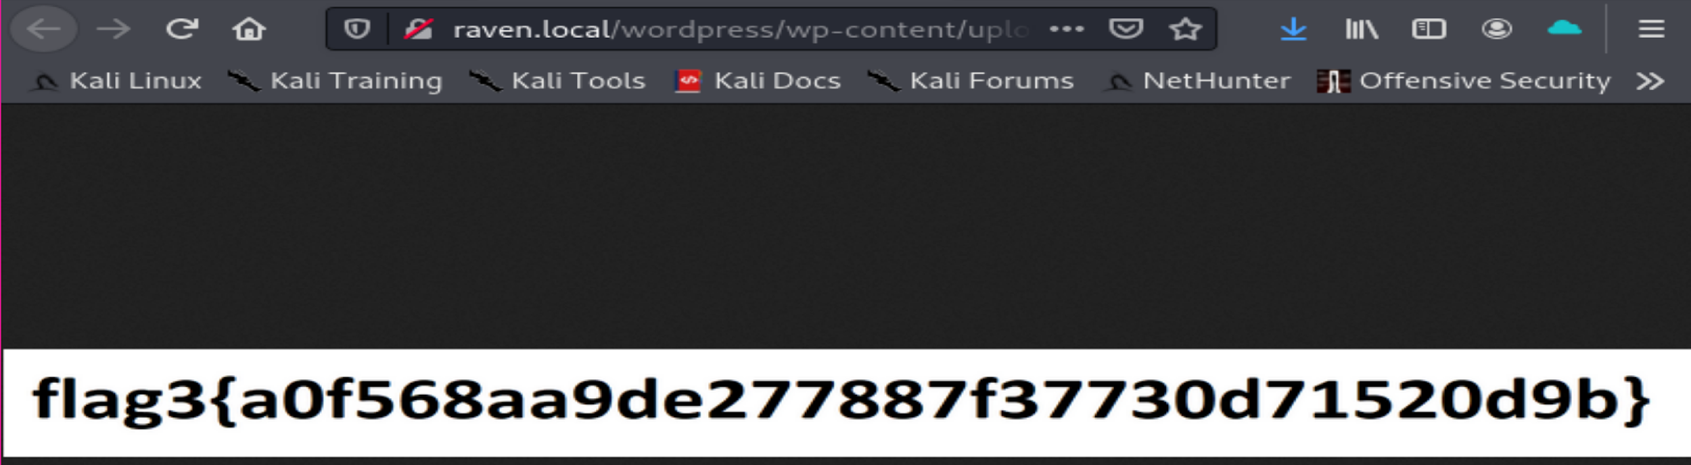
Exploitation of target 2: [open access to sensitive data]
Through viewing the wp-config.php file the attacker found the mysql password for the root user.
This exploit set the stage for a full unauthorized privilege escalation, it also gave access to flag3 and 2 hashed passwords for user accounts (though the passwords were too strong to easily crack)
Notes:
William Hart

Slide 18
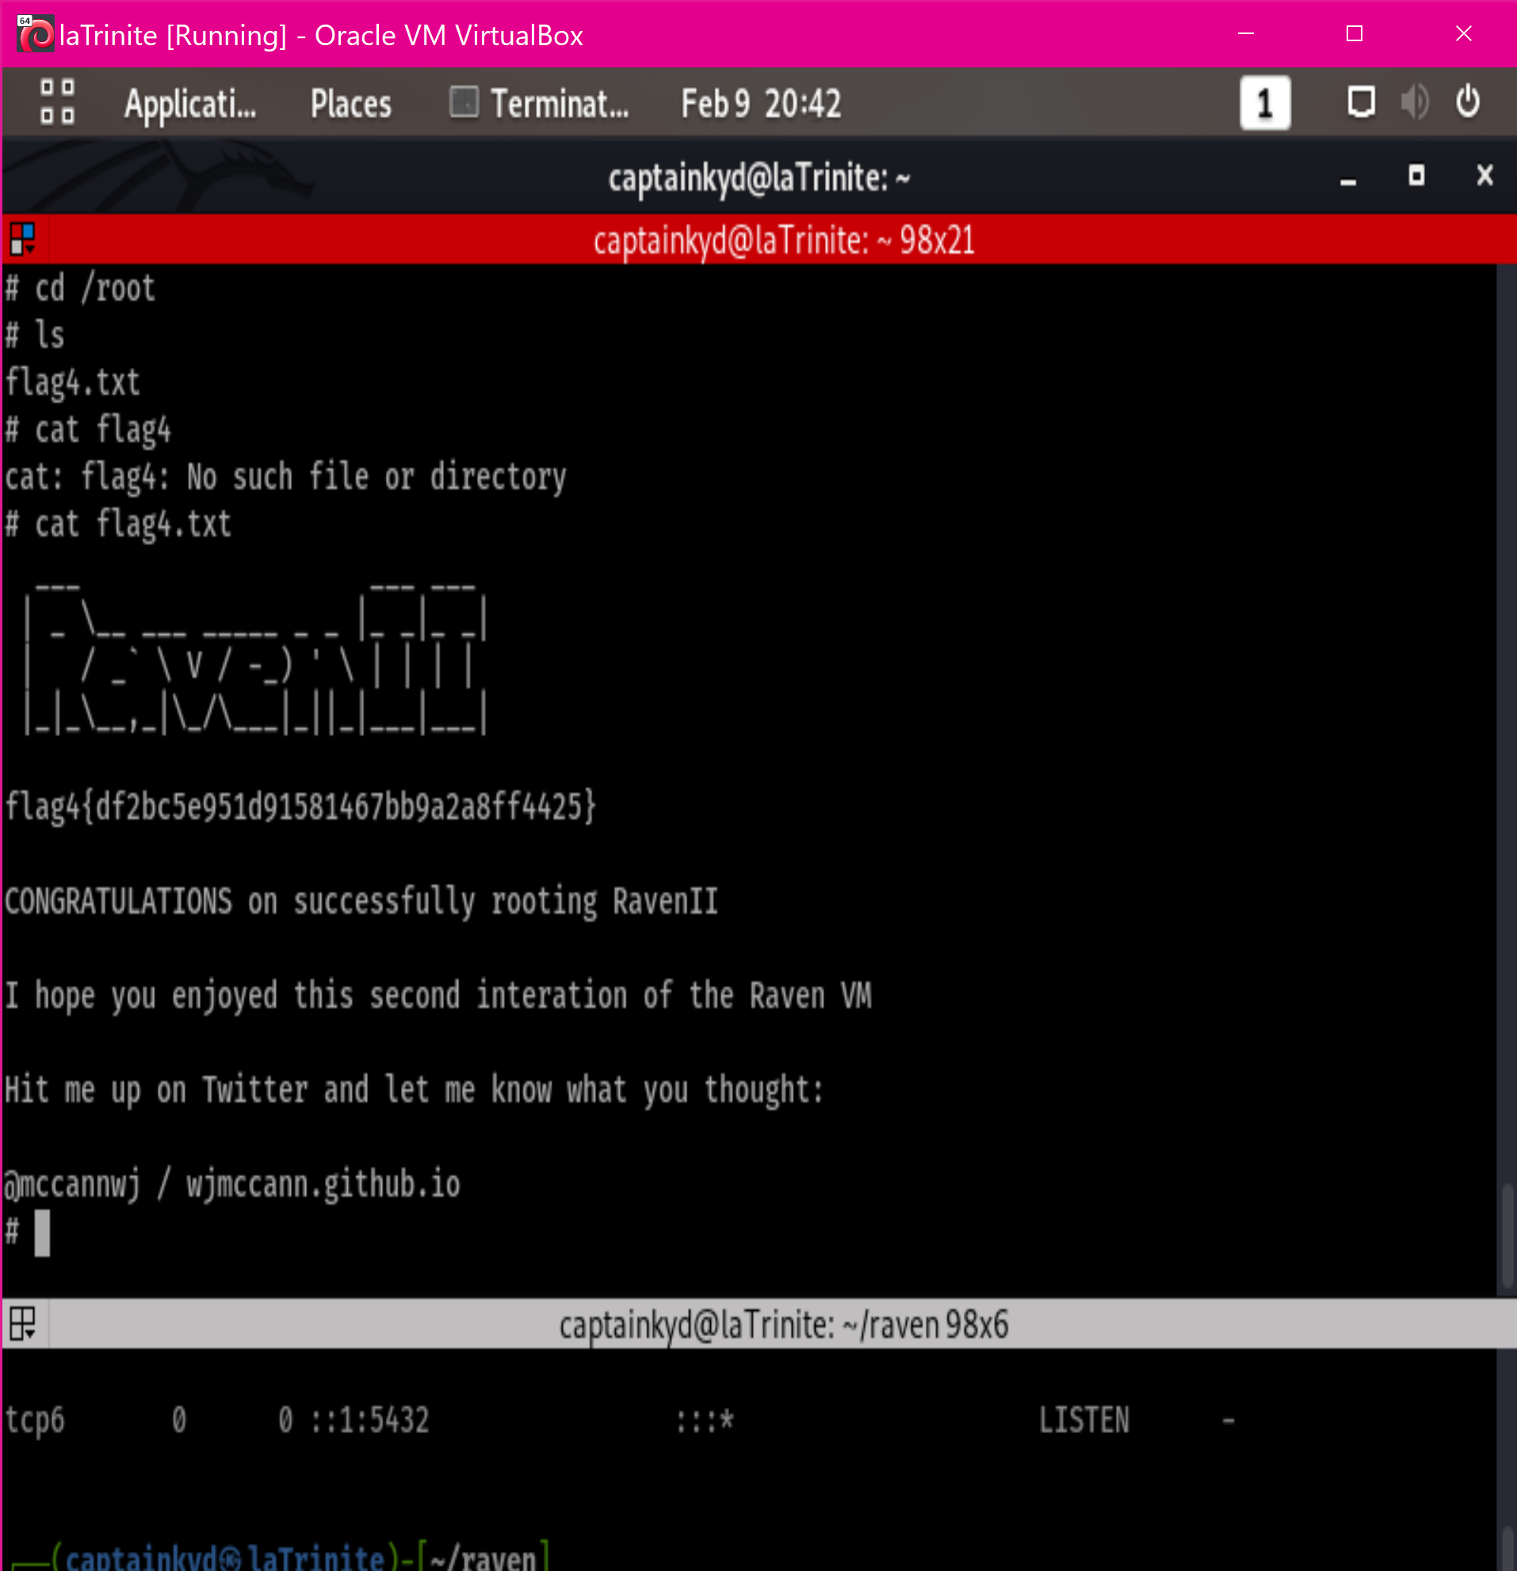
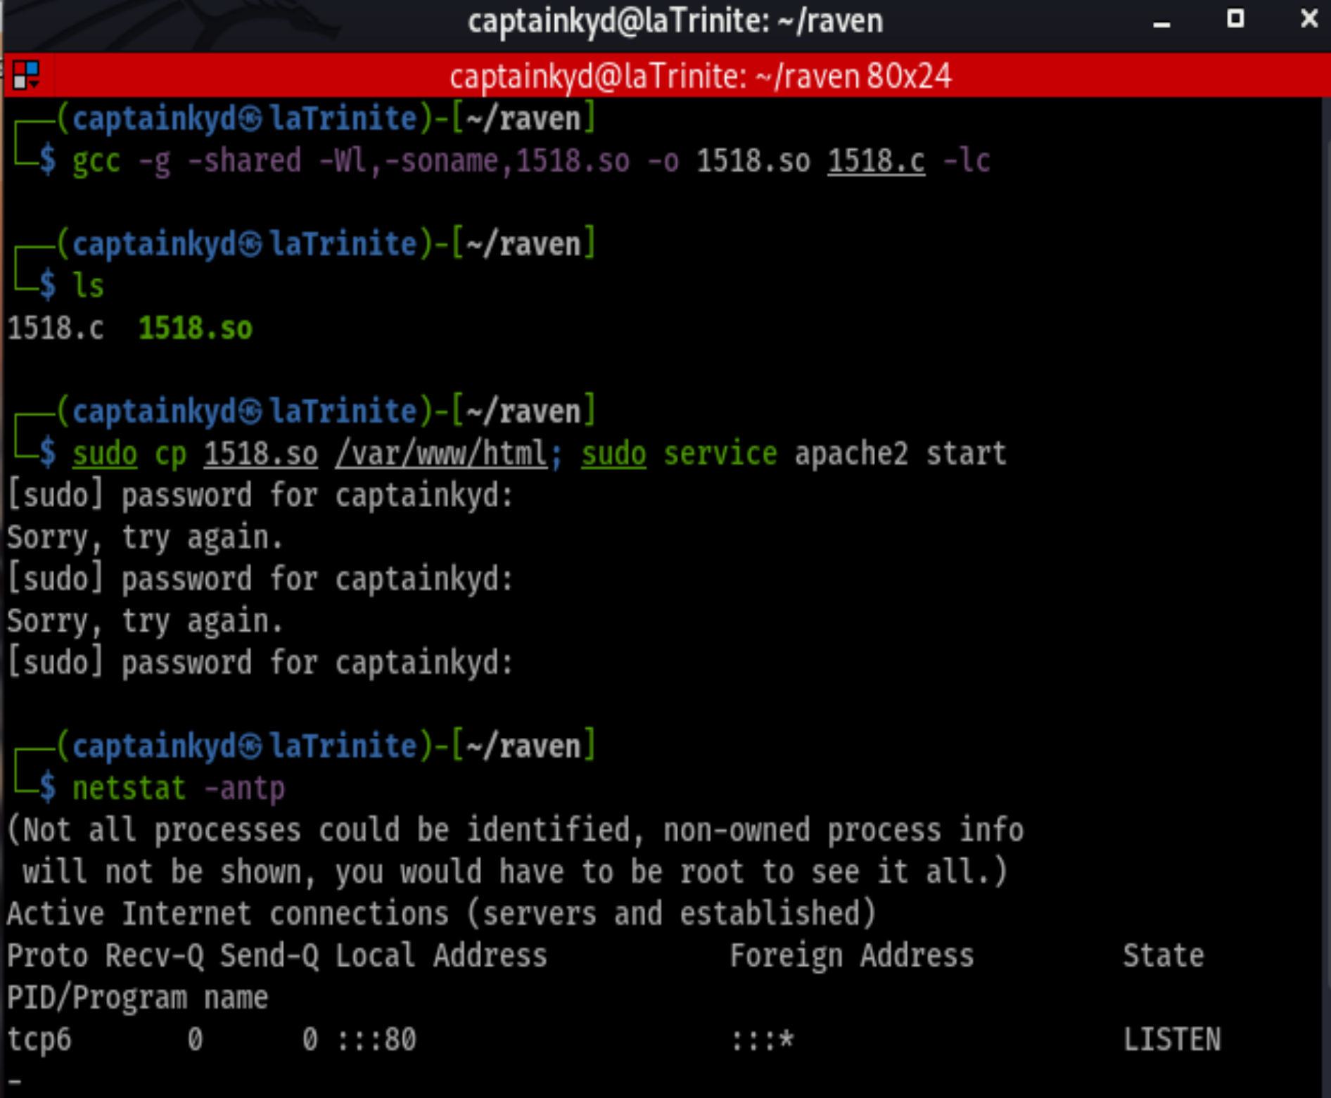
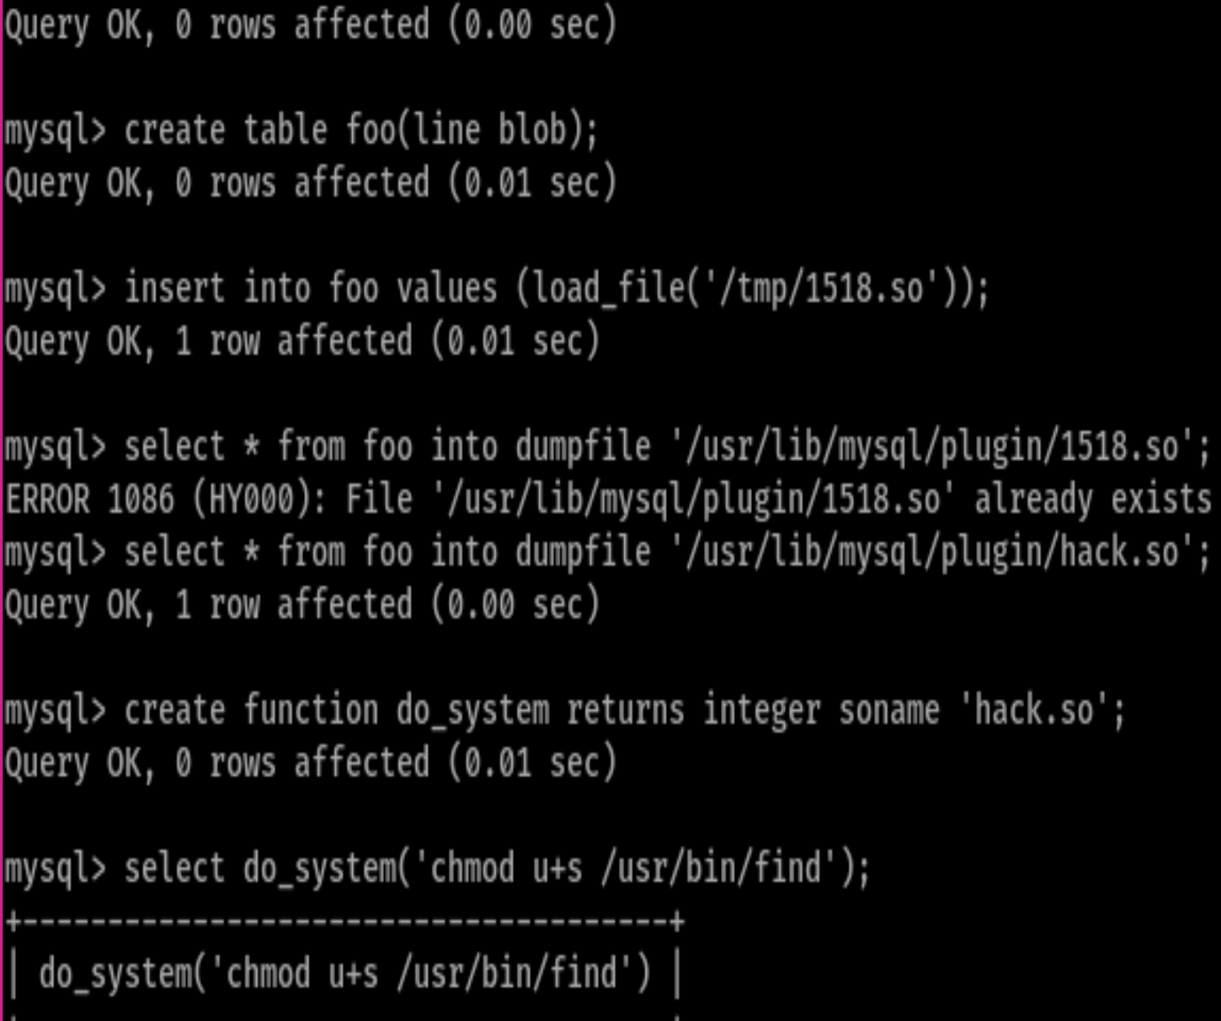
Exploitation of target 2: [privilege escalation (mysql UDF DL)]
By custom compiling a malicious .so file uploaded to the machine via wget and installed into the root instance of mysql a path to root opened using the find command. (exploit 1518.c downloaded from exploit-db.com)
TOTAL PWNAGE netting the 4th and final flag
Notes:
William Hart

Slide 19
Avoiding Detection
19

Slide 20
Stealth Exploitation of [open access to ssh]
Monitoring Overview
SSH login alert
Monitors Port 22(SSH) for unauthorized access
Triggers whenever any user attempts to access the system via SSH
Mitigating Detection
Use a jump server in the network
Attack using a different port

Slide 21
Stealth Exploitation of Enumerate usernames in WordPress
Monitoring Overview
HTTP Response Status Code Alert
Measures any response status codes that may be set off.
Triggered at thresholds above 400 times in 5 minutes.
Mitigating Detection
Use command line sniffing rather than automated program like wpscan

Slide 22
Stealth Exploitation of Brute Force Attack
Monitoring Overview
Excessive HTTP Alert
This alert measures the number of times an HTTP Response Status code is over 400 specifically for 401 in relation to brute force attack
The alert would fire at a threshold of more than 400 attempts in 5 minutes.
Mitigating Detection
Limiting and spacing out the brute-force attempts so that it will not set of alarm
Hydra is another option as well

Slide 23
Maintaining Access
23

Slide 24
Backdooring Target
Backdoor Overview
A hidden user with ssh access was created with passwordless sudo access.
Installed through the root shell.
adduser –no-create-home {username}
visudo
The following entry was added to the sudoers file
{username} ALL=(ALL) NOPASSWD:ALL
The user is connected to via ssh
ssh {username}@{targetIP}
Notes:
William Hart

